Slide 1
Volume Scattering Update
07/31/25
Payton Linton

Slide 2
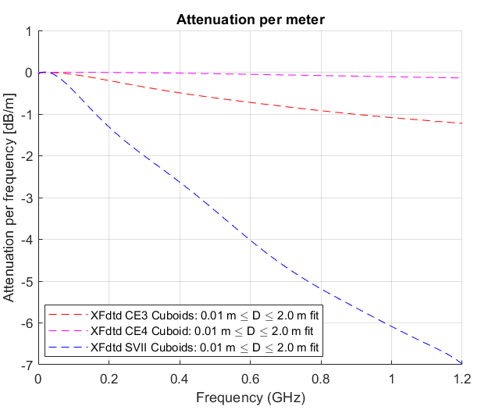
Reminder
Using the waveguide model we were able to get forward scattering attenuation curves by measuring the S21
This was done for 3 rock distributions
CE4
CE3
SVII
Rocks were modeled as cuboids where their height and width were sampled from models of these rocks h/D and b/D ratios

Slide 3
Issues
Waveguide method is really only good for forward scattering attenuation
Its unclear how scattered power falls into higher modes
Makes it impossible to apply dedispersion from waveguide to get time domain results
Wanted to see if there would be any coherent xpol scattering
Interested in actual waveforms
How much dispersion occurs from volume scattering?
Xpol?

Slide 4
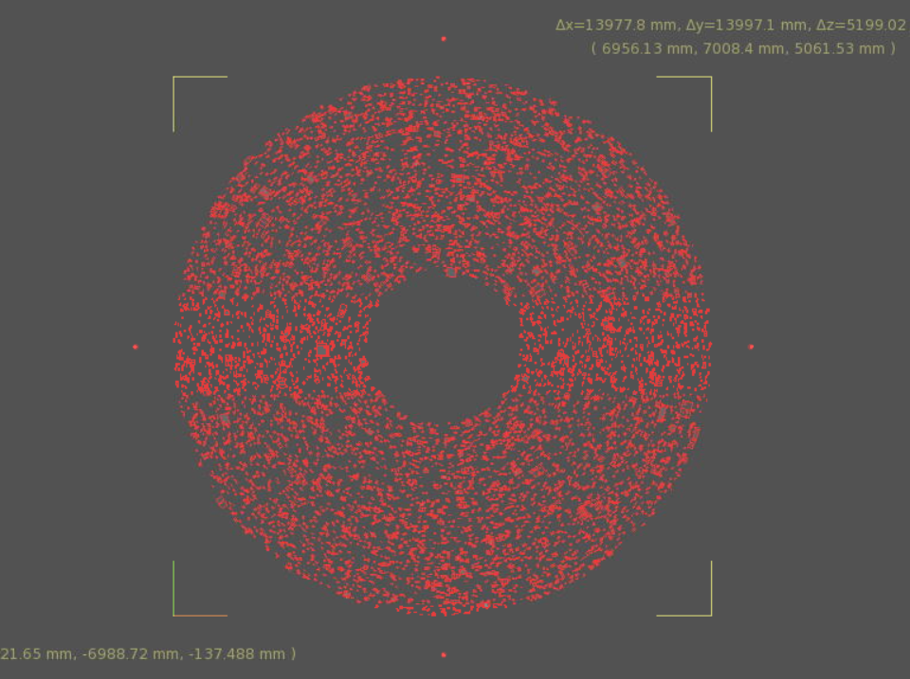
Dipole source
Before Palestine we talked about other transmission line set ups that don’t have dispersion
Peter recommended coax or parallel plate
Coax it was unclear how you could study xpol since the fields go radially outwards
Parallel plate suffered from fringe patterns from the plates having a fine end
I had a discussion with Philipp and he suggested just creating a source
Since a dipole has azimuthal symmetry, I populated rocks in shell around dipole
For rock distribution with some orientation, this is okay as long as the rocks are much smaller than a solid angle
I can collect E-field around the outside
Average over many different realizations

Slide 5
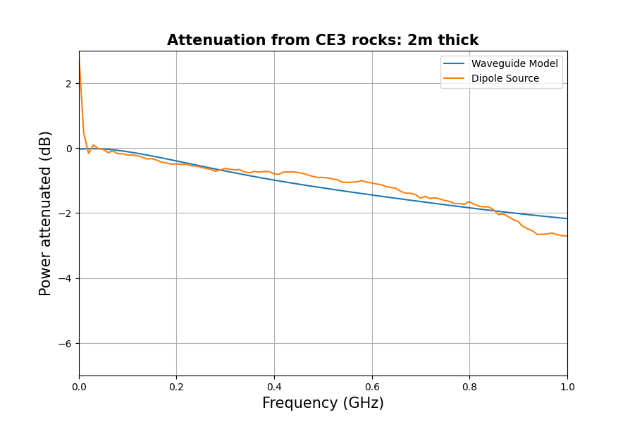
Results
Requires a lot more simulations to gather statistics
But it does appear to be converging to the waveguide model
It’s a nice double check
For CE3 and CE4, rocks are small enough that this works
SVII I think rocks are too big but still checking

Slide 6
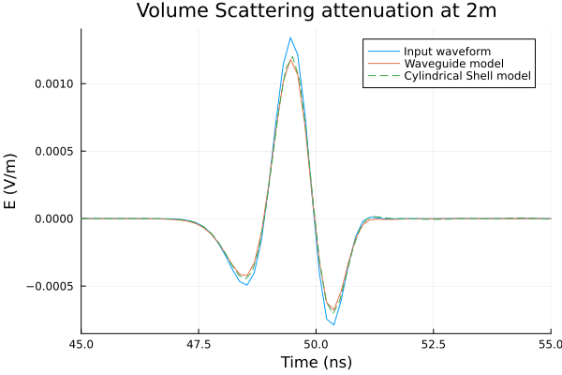
Waveforms?
Waveform captured by point sensor 8m away from dipole was used as the reference waveform
Cylindrical shell model is from dipole with 2m of CE3 rocks distributed between 2-4 m from dipole
These were oriented with their largest face towards the center
Waveform is the cross correlated average of 1600 waveforms
Waveguide model waveform is from taking the attenuation per meter curve attained earlier and applying it to the input waveform at 2m
They match exceptionally well!
Code that applies waveguide attenuation is written as a Julia function
Takes in time and waveform vectors, distance, and a distribution name
With some modifications can be put into monte carlo

Slide 7








Xpol
$$E_{θ}$$
To do Xpol, have to choose a direction to be positive
This is essentially cylindrical coordinates with E oriented in z
→ Natural choice for Xpol is in θ-direction
For Xpol scattering to be coherent, there would need to be a preferred orientation
If each Xpol event gave random polarity then on average theres just as much + as – and you get 0
Rotating the system by 180 should produce opposite polarity
$$E_{z}$$
$$E_{θ}$$
$$E_{z}$$
$$E_{z}$$
$$E_{θ}$$
$$E_{z}$$
$$E_{θ}$$

Slide 8
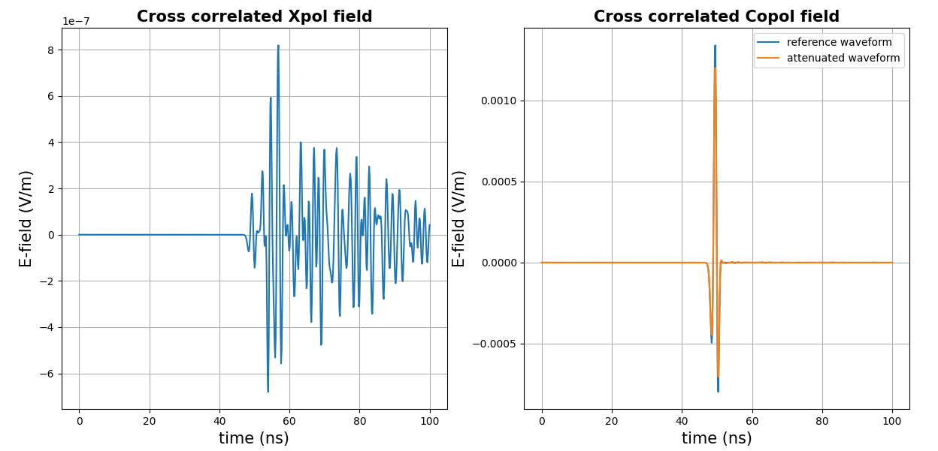
Xpol
Using this I get Xpol waveform that’s ~3 orders of magnitude less by amplitude
Rock orientation was such that field hit normal to their largest face
This came out of our conversation that rocks preferably land with their largest face oriented up
Can add a small angular distribution
What should this be?
Many CR events have the bottom of the cone essentially going straight down
Top of the cone would see rocks oriented at some preferred angle
→ I would expect this to contribute more Xpol
Would like to test that this Xpol idea works with some geometry with an analytical Xpol effect
Conducting rods?

